Slide 1
Geometric Gradients
Geometric gradients change by the same percentage each period
Cash flow diagram for present worth
of geometric gradient
There are no tables for geometric factors
Use following equation for g ≠ i:
P_{g} = ?
1
2
3
4
n
P_{g} = A₁{1- [(1+g)/(1+i)]^{n}}/(i-g)
0
where: A₁ = cash flow in period 1
g = rate of increase
If g = i, P_{g} = A₁n/(1+i)
A₁
A ₁(1+g)¹
A ₁(1+g)²
Note: g starts between
periods 1 and 2
A ₁(1+g)^{n-1}
Note: If g is negative, change signs in front of both g values

Slide 2
Example: Geometric Gradient
Find the present worth of $1,000 in year 1 and amounts increasing by 7% per year through year 10. Use an interest rate of 12% per year.
(a) $5,670 (b) $7,333 (c) $12,670 (d) $13,550
P_{g} = ?
Solution:
i = 12%
1
2
3
4
10
P_{g} = 1000[1-(1+0.07/1+0.12)¹⁰]/(0.12-0.07)
= $7,333
0
1000
1070
Answer is ?
1145
g = 7%
1838
To find A, multiply P_{g} by (A/P,12%,10)

Slide 3
Unknown Interest Rate i
Unknown interest rate problems involve solving for i,
given n and 2 other values (P, F, or A)
(Usually requires a trial and error solution or interpolation in interest tables)
Procedure: Set up equation with all symbols involved and solve for i
A contractor purchased equipment for $60,000 which provided income of $16,000 per year for 10 years. The annual rate of return of the investment was closest to:
(a) 15% (b) 18% (c) 20% (d) 23%
Solution:
Can use either the P/A or A/P factor. Using A/P:
60,000(A/P,i%,10) = 16,000
(A/P,i%,10) = 0.26667
From A/P column at n = 10 in the interest tables, i is between 22% and 24%
Answer is (d)

Slide 4
Unknown Recovery Period n
Unknown recovery period problems involve solving for n,
given i and 2 other values (P, F, or A)
(Like interest rate problems, they usually require a trial & error solution or interpolation in interest tables)
Procedure: Set up equation with all symbols involved and solve for n
A contractor purchased equipment for $60,000 that provided income of $8,000
per year. At an interest rate of 10% per year, the length of time required to recover
the investment was closest to:
(a) 10 years (b) 12 years (c) 15 years (d) 18 years
Solution:
Can use either the P/A or A/P factor. Using A/P:
60,000(A/P,10%,n) = 8,000
(A/P,10%,n) = 0.13333
From A/P column in i = 10% interest tables, n is between 14 and 15 years
Answer is (c)

Slide 5
Summary of Important Points
In P/A and A/P factors, P is one period ahead of first A
In F/A and A/F factors, F is in same period as last A
To find untabulated factor values, best way is to use formula or spreadsheet
For arithmetic gradients, gradient G starts between periods 1 and 2
Arithmetic gradients have 2 parts, base amount (year 1) and gradient amount
For geometric gradients, gradient g starts been periods 1 and 2
In geometric gradient formula, A₁ is amount in period 1
To find unknown i or n, set up equation involving all terms and solve for i or n

Slide 6
Shifted Series

Slide 7
Shifted Uniform Series
A shifted uniform series starts at a time other than period 1
The cash flow diagram below is an example of a shifted series
Series starts in period 2, not period 1
A = Given
F_{A} = ?
Shifted series usually
require the use of
multiple factors
0
1
2
3
4
5
P_{A} = ?
Remember: When using P/A or A/P factor, P_{A} is always one year ahead
of first A
When using F/A or A/F factor, F_{A} is in same year as last A

Slide 8
Example Using P/A Factor: Shifted Uniform Series
The present worth of the cash flow shown below at i = 10% is:
(a) $25,304 (b) $29,562 (c) $34,462 (d) $37,908
P₀ = ?
P₁ = ?
i = 10%
Actual year
0 1 2 3 4 5 6
0 1 2 3 4 5
Series year
A = $10,000
Solution: (1) Use P/A factor with n = 5 (for 5 arrows) to get P₁ in year 1
(2) Use P/F factor with n = 1 to move P₁ back for P₀ in year 0
P₀ = P₁(P/F,10%,1) = A(P/A,10%,5)(P/F,10%,1) = 10,000(3.7908)(0.9091) = $34,462

Slide 9
Example Using F/A Factor: Shifted Uniform Series
How much money would be available in year 10 if $8000 is deposited each year in years 3 through 10 at an interest rate of 10% per year?
Cash flow diagram is:
F_{A} = ?
i = 10%
Actual year
0 1 2 3 4 5 6 7 8 9 10
0 1 2 3 4 5 6 7 8
Series year
A = $8000
Solution:
Re-number diagram to determine n = 8 (number of arrows)
F_{A} = 8000(F/A,10%,8)
= 8000(11.4359)
= $91,487

Slide 10
Shifted Series and Random Single Amounts
For cash flows that include uniform series and randomly placed single amounts:
Uniform series procedures are applied to the series amounts
Single amount formulas are applied to the one-time cash flows
The resulting values are then combined per the problem statement
The following slides illustrate the procedure

Slide 11

Example: Series and Random Single Amounts
Find the present worth in year 0 for the cash flows
shown using an interest rate of 10% per year.
P_{T} = ?
i = 10%
0 1 2 3 4 5 6 7 8 9 10
A = $5000
$2000
P_{T} = ?
i = 10%
Actual year
0 1 2 3 4 5 6 7 8 9 10
0 1 2 3 4 5 6 7 8
Series year
A = $5000
$2000
Solution:
First, re-number cash flow diagram to get n for uniform series: n = 8

Slide 12
Example: Series and Random Single Amounts
P_{A}
P_{T} = ?
i = 10%
0 1 2 3 4 5 6 7 8 9 10
Actual year
0 1 2 3 4 5 6 7 8
Series year
A = $5000
$2000
Use P/A to get P_{A} in year 2: P_{A} = 5000(P/A,10%,8) = 5000(5.3349) = $26,675
Move P_{A} back to year 0 using P/F: P₀ = 26,675(P/F,10%,2) = 26,675(0.8264) = $22,044
Move $2000 single amount back to year 0: P₂₀₀₀ = 2000(P/F,10%,8) = 2000(0.4665) = $933
Now, add P₀ and P₂₀₀₀ to get P_{T}: P_{T} = 22,044 + 933 = $22,977

Slide 13
Example Worked a Different Way
(Using F/A instead of P/A for uniform series)
The same re-numbered diagram from the previous slide is used
P_{T} = ?
F_{A} = ?
i = 10%
0 1 2 3 4 5 6 7 8 9 10
0 1 2 3 4 5 6 7 8
A = $5000
$2000
Solution:
Use F/A to get F_{A} in actual year 10: F_{A} = 5000(F/A,10%,8) = 5000(11.4359) = $57,180
Move F_{A} back to year 0 using P/F: P₀ = 57,180(P/F,10%,10) = 57,180(0.3855) = $22,043
Move $2000 single amount back to year 0: P₂₀₀₀ = 2000(P/F,10%,8) = 2000(0.4665) = $933
Now, add two P values to get P_{T}: P_{T} = 22,043 + 933 = $22,976
Same as before
As shown, there are usually multiple ways to work equivalency problems

Slide 14
Example: Series and Random Amounts
Convert the cash flows shown below (black arrows) into
an equivalent annual worth A in years 1 through 8 (red arrows)
at i = 10% per year.
A = ?
0 1 2 3 4 5 6 7 8
i = 10%
0 1 2 3 4 5
A = $3000
$1000
Approaches:
1. Convert all cash flows into P in year 0 and use A/P with n = 8
2. Find F in year 8 and use A/F with n = 8
Solution:
Solve for F: F = 3000(F/A,10%,5) + 1000(F/P,10%,1)
= 3000(6.1051) + 1000(1.1000)
= $19,415
Find A: A = 19,415(A/F,10%,8)
= 19,415(0.08744)
= $1698

Slide 15
Shifted Arithmetic Gradients
Shifted gradient begins at a time other than between periods 1 and 2
Present worth P_{G} is located 2 periods before gradient starts
Must use multiple factors to find P_{T} in actual year 0
To find equivalent A series, find P_{T} at actual time 0 and apply (A/P,i,n)

Slide 16
Example: Shifted Arithmetic Gradient
John Deere expects the cost of a tractor part to increase by $5 per year beginning 4 years from now. If the cost in years 1-3 is $60, determine the present worth in year 0 of the cost through year 10 at an interest rate of 12% per year.
P_{T} = ?
i = 12%
Actual years
0
1
2
3
4
5
10
0 1 2 3 8
Gradient years
60
60
60
65
70
G = 5
95
Solution:
First find P₂ for G = $5 and base amount ($60) in actual year 2
P₂ = 60(P/A,12%,8) + 5(P/G,12%,8) = $370.41
P₀ = P₂(P/F,12%,2) = $295.29
Next, move P₂ back to year 0
Next, find P_{A} for the $60 amounts of years 1 and 2
P_{A} = 60(P/A,12%,2) = $101.41
Finally, add P₀ and P_{A} to get P_{T} in year 0
P_{T} = P₀ + P_{A} = $396.70

Slide 17
Shifted Geometric Gradients
Shifted gradient begins at a time other than between periods 1 and 2
Equation yields P_{g} for all cash flows (base amount A₁ is included)
Equation (i ≠ g):
P_{g} = A ₁{1 - [(1+g)/(1+i)]^{n}/(i-g)}
For negative gradient, change signs on both g values
There are no tables for geometric gradient factors

Slide 18
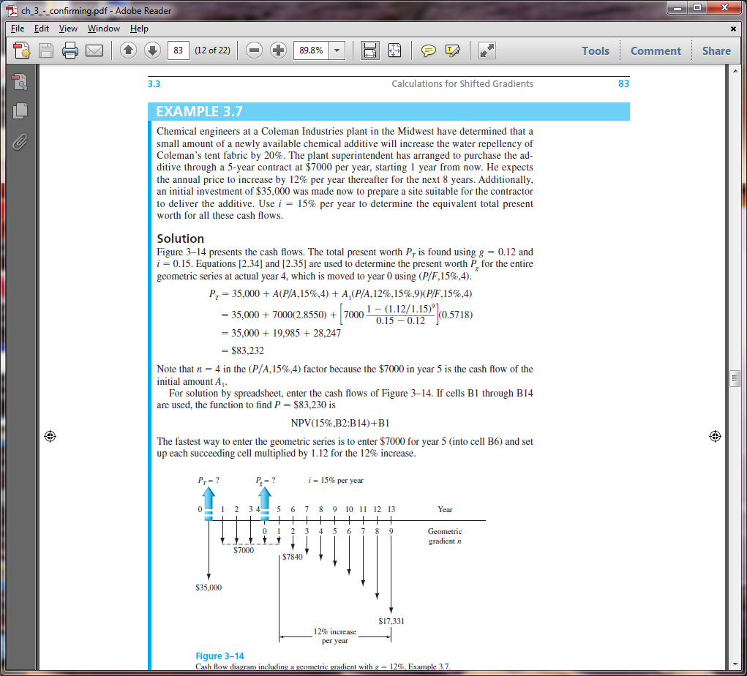
Example: Shifted Geometric Gradient
Weirton Steel signed a 5-year contract to purchase water treatment chemicals from a local distributor for $7000 per year. When the contract ends, the cost of the chemicals is expected to increase by 12% per year for the next 8 years. If an initial investment in storage tanks is $35,000, determine the equivalent present worth in year 0 of all of the cash flows at i = 15% per year.

Slide 19
Example: Shifted Geometric Gradient
Gradient starts between actual years 5 and 6; these are gradient years 1 and 2.
P_{g} is located in gradient year 0, which is actual year 4
P_{g} = 7000{1-[(1+0.12)/(1+0.15)]⁹/(0.15-0.12)} = $49,401
Move P_{g} and other cash flows to year 0 to calculate P_{T}
P_{T} = 35,000 + 7000(P/A,15%,4) + 49,401(P/F,15%,4) = $83,232

Slide 20
Negative Shifted Gradients
For negative arithmetic gradients, change sign on G term from + to -
General equation for determining P: P = present worth of base amount - P_{G}
Changed from + to -
For negative geometric gradients, change signs on both g values
Changed from + to -
P_{g} = A₁{1-[(1-g)/(1+i)]^{n}/(i+g)}
Changed from - to +
All other procedures are the same as for positive gradients

Slide 21
Example: Negative Shifted Arithmetic Gradient
For the cash flows shown, find the future worth in year 7 at i = 10% per year
F = ?
P_{G} = ?
i = 10%
Actual years
0 1 2 3 4 5 6 7
0 1 2 3 4 5 6
Gradient years
500
450
600
550
700
650
G = $-50
Solution:
Gradient G first occurs between actual years 2 and 3; these are gradient years 1 and 2
P_{G} is located in gradient year 0 (actual year 1); base amount of $700 is in gradient years 1-6
P_{G} = 700(P/A,10%,6) – 50(P/G,10%,6) = 700(4.3553) – 50(9.6842) = $2565
F = P_{G}(F/P,10%,6) = 2565(1.7716) = $4544

Slide 22


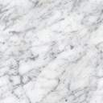
Summary of Important Points
P for shifted uniform series is one period ahead of first A;
n is equal to number of A values
F for shifted uniform series is in same period as last A;
n is equal to number of A values
For gradients, first change equal to G or g occurs
between gradient years 1 and 2
For negative arithmetic gradients, change sign on G from + to -
For negative geometric gradients, change sign on g from + to -

